Slide 1
Incentives for Early Arrival in Cost Sharing
Junyu Zhang¹, Yao Zhang², Yaoxin Ge¹, Dengji Zhao¹, Hu Fu³, Zhihao Gavin Tang³, Pinyan Lu³
¹ShanghaiTech University
²Kyushu University ³Shanghai University of Finance and Economics

Slide 2
Content
Preliminary
Motivation
Properties
Mechanism
A Class of Mechanisms
General Valued Games

Slide 3
Cost Sharing
Players receive a service as a coalition, which causes cost.
Determine how to share the cost:
Shapley value, core, …
A
A
3
A B
5
B
A
1
B C
3
6
B
C
C
2
C A
4

Slide 4
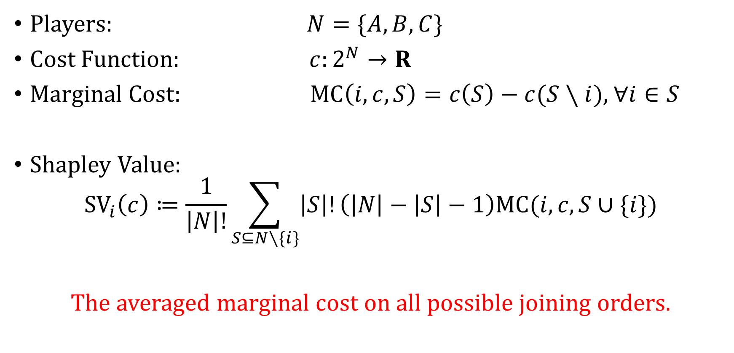
Cost Sharing and Shapley Value
Players: $N=\{A,B,C\}$
Cost Function: $c:2^{N}→R$
Marginal Cost: $\text{MC}\left(i,c,S\right)=c\left(S\right)−c(S∖i)$, $∀i∈S$
Shapley Value:
$${SV}_{i}\left(c\right)≔\frac{1}{\left|N\right|!}\sum_{S⊆N∖\{i\}}{\left|S\right|!\left(\left|N\right|−\left|S\right|−1\right)MC(i,c,S∪\{i\})}$$
The averaged marginal cost on all possible joining orders.
Notes:
形式化
In this work, we write $v=[v\left(A\right),v\left(B\right),v\left(C\right),v\left(AB\right),v\left(AC\right),v\left(BC\right),v(ABC)]$

Slide 5

Shapley Value
SV: Averaged MC on all orders
E.g.
Coalition | A | B | C | AB | AC | BC | ABC
Cost | 3 | 1 | 2 | 5 | 4 | 3 | 6
C
A
B
B
C
A
A
B
C
2
2
2
1
2
3
3
2
1
A
C
B
C
B
A
B
A
C
3
1
2
2
1
3
1
4
1
$$\text{S}{\text{V}}_{A}=\frac{2+3+3+3+3+4}{6}=3$$
Notes:
传统的合作博弈里面，需要合作工作做完才能去算每个人分多少钱

Slide 6




Online Cost Sharing: Join Order Matters
100
A
Quantity | Average Cost
100 | 80
300 | 75
500 | 70
200
B
shirt factory
C
200
Notes:
TBD

Slide 7
Online Cost Sharing
Joining order
A
B
C
Unknown
Total cost after joining
3 5 6 …
Marginal cost (MC)
3 2 1 …
How to share the cost
?

Slide 8
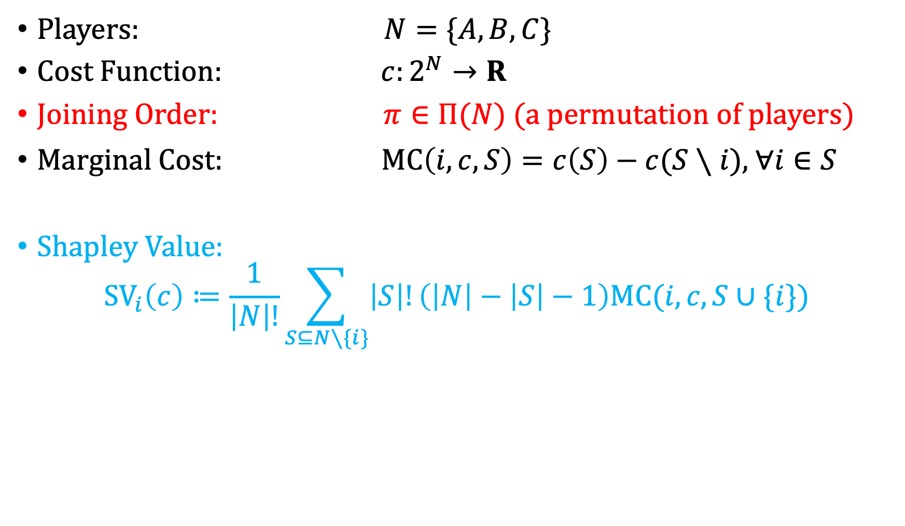
Online Cost Sharing Model
Players: $N=\{A,B,C\}$
Cost Function: $c:2^{N}→R$
Joining Order: $π∈Π(N)$ (a permutation of players)
Marginal Cost: $\text{MC}\left(i,c,S\right)=c\left(S\right)−c(S∖i)$, $∀i∈S$
Shapley Value:
$${SV}_{i}\left(c\right)≔\frac{1}{\left|N\right|!}\sum_{S⊆N∖\{i\}}{\left|S\right|!\left(\left|N\right|−\left|S\right|−1\right)MC(i,c,S∪\{i\})}$$
Notes:
除了多了一个排序以外，我们还是“近视眼”

Slide 9
Online Value Sharing Game
Ge et al. "Incentives for Early Arrival in Cooperative Games." AAMAS 2024 (The Best Paper Award)
they proposed solutions for:
Incentives for Early Arrival
Shapley Fair
Online Individual Rational

Slide 10

Incentivizing for Early Arrival (I4EA)
$$…$$
A
B
C
Unknown
I4EA: When the order of others are fixed, the players are incentivized to join as soon as possible.
One Solution: The Last Player Takes All, but it is not fair
Notes:
弧线

Slide 11
One Fairness: Shapley Fair (SF)
A
B
C
A
C
B
B
A
C
B
C
A
average
Shapley value
C
A
B
C
B
A
SF: The expected share to a player equals her Shapley value.

Slide 12

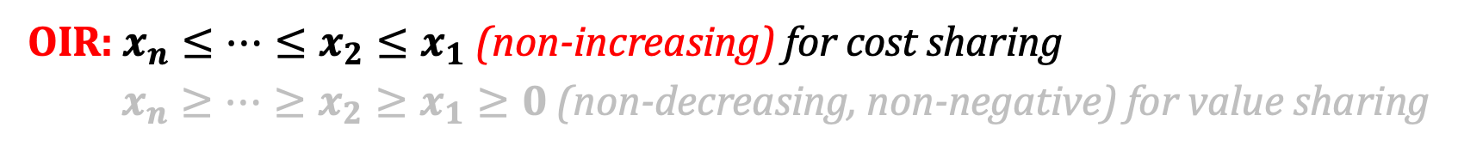


Online Individual Rational (OIR)
A
Unknown
$$x_{1}$$
A
Unknown
$$x_{2}$$
…
A
…
$$x_{n}$$
OIR: $x_{n}≤…≤x_{2}≤x_{1}$ (non-increasing) for cost sharing
$x_{n}≥…≥x_{2}≥x_{1}≥0$ (non-decreasing, non-negative) for value sharing

Slide 13



All the Properties
Incentivizing for Early Arrival (I4EA)
Shapley-fair (SF)
Online Individual Rational (OIR)
A
B
average
Shapley value
A
B
Unknown
A
B
C
Unknown
$$x$$
$$≤x$$

Slide 14
The Solution for Online Value Sharing
I4EA
SF
Reward First Critical Player (RFC) for 0-1 value sharing
OIR
[1] Ge et al. "Incentives for Early Arrival in Cooperative Games." Proceedings of the 23rd International Conference on Autonomous Agents and Multiagent Systems. 2024 (Best Paper Award)

Slide 15
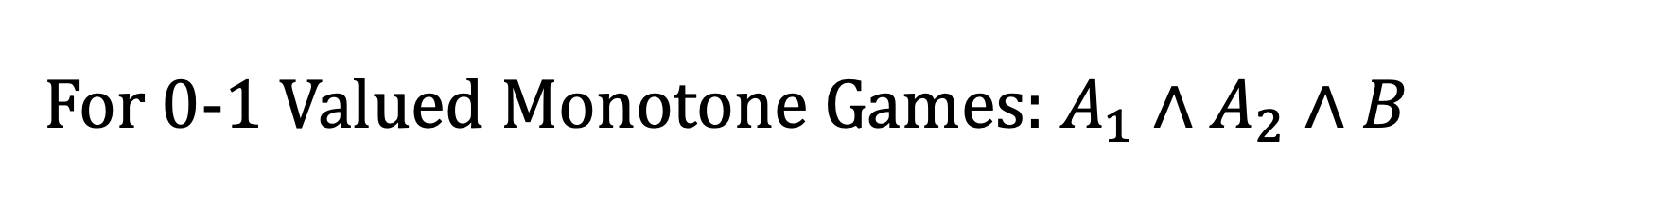
For 0-1 Valued Monotone Games: $A_{1}∧A_{2}∧B$
Order
…
B
Unknown
Value
0 … 0 1 1 1 ... 1
MC
0 … 0 1 0 0 ... 0
Marginal Player: B is the only player who creates a MC of 1.

Slide 16
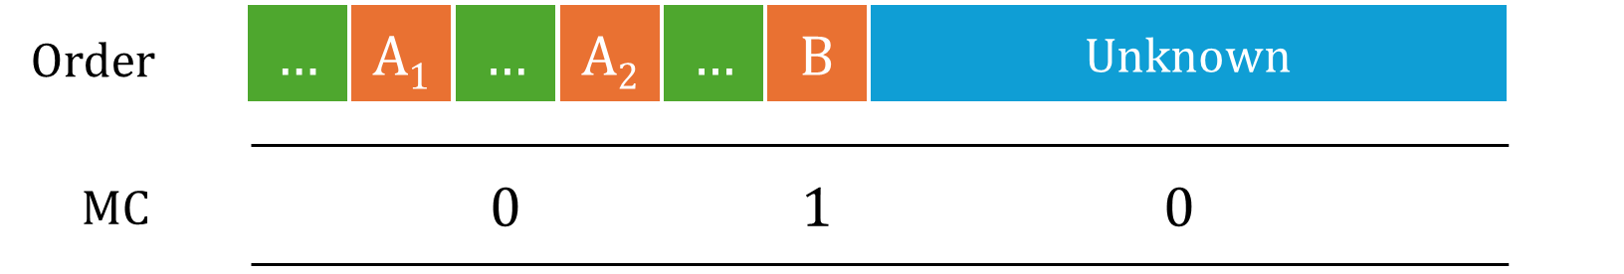



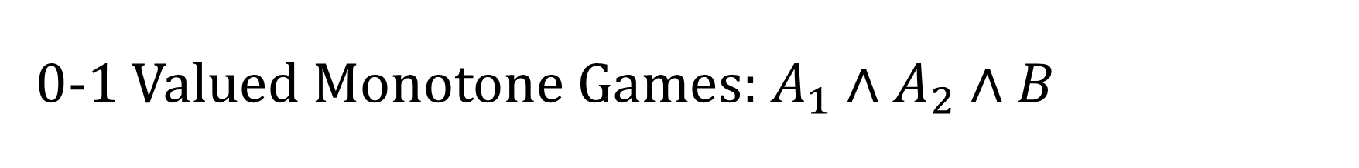
0-1 Valued Monotone Games: $A_{1}∧A_{2}∧B$
S
Critical Players: $\left\{i | v\left(S∖\{i\}\right)=0\right\}$

Slide 17
Reward First Critical Player (RFC)
Definition: RFC
Give the MC of the marginal player to the first critical player in $S$.
1
Order
…
A₁
…
A₂
…
B
Unknown
MC
1
Share
1

Slide 18
Can we apply RFC to cost sharing?
1
Value sharing
…
A
…
B
Unknown
The value allocation is a one-time decision
1
1
Cost sharing
…
A
…
B
…
C
…
D
Unknown
The cost allocation should be updated when more players arrive

Slide 19






















































New Solution: an order shuffling works!
e.g. 0-1 Valued Monotone Game: $A∨(B∧C)$
A B C
Original Order
Shuffled Order
$$A$$
$$B$$
$$C$$
$$B$$
$$C$$
$$A$$
$$0$$
$$0$$
$$1$$
$$A$$
$$C$$
$$B$$
$$C$$
$$B$$
$$A$$
$$0$$
$$1$$
$$0$$
Apply Marginal Cost Allocation
$$B$$
$$A$$
$$C$$
Bijective Shuffle
$$C$$
$$A$$
$$B$$
$$1$$
$$0$$
$$0$$
$$B$$
$$C$$
$$A$$
$$A$$
$$B$$
$$C$$
$$1$$
$$0$$
$$0$$
$$C$$
$$A$$
$$B$$
$$B$$
$$A$$
$$C$$
$$1$$
$$0$$
$$0$$
$$C$$
$$B$$
$$A$$
$$A$$
$$C$$
$$B$$
$$1$$
$$0$$
$$0$$

Slide 20
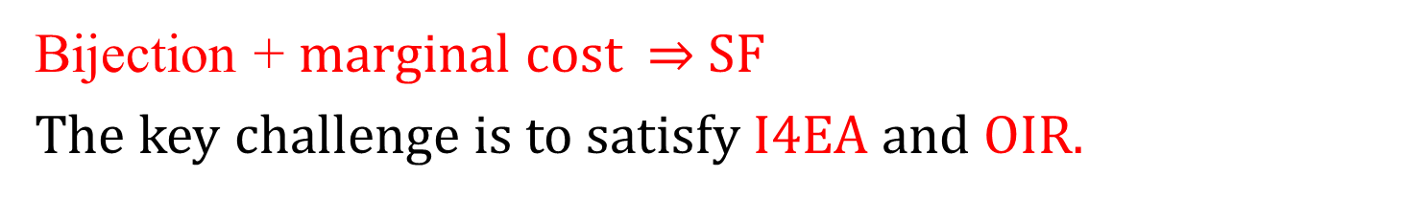
Shuffle-based Cost Sharing Mechanisms
Bijective Shuffle
Apply Marginal Cost Allocation
Original Order
Shuffled Order
Cost Share
Bijection + marginal cost $⇒$ SF
The key challenge is to satisfy I4EA and OIR.

Slide 21
Shapley-fair Shuffle Cost Sharing Mechanism(SFS-CS)
Definition: sfs-shuf
When a new player arrives:
Case 1. Insert her to the first position such that she is the marginal player of the shuffled order if it can be done.
Case 2. Otherwise, insert her in the shuffled order before her predecessor in the original order.
Theorem
SFS-CS is I4EA, SF, OIR on every 0-1 valued monotone cost sharing game.

Slide 22

$$1$$
Original Order
Shuffled Order

Slide 23
$$1$$
Original Order
Shuffled Order

Slide 24
$$1$$
Original Order
is marginal player
Shuffled Order

Slide 25
$$1$$
Original Order
Shuffled Order

Slide 26

$$1$$
Original Order
$$1$$
Shuffled Order

Slide 27

$$1$$
$$2$$
Original Order
$$1$$
Shuffled Order

Slide 28

$$1$$
$$2$$
Original Order
$$1$$
Shuffled Order

Slide 29
$$1$$
$$2$$
Original Order
is marginal player
$$1$$
Shuffled Order

Slide 30


$$1$$
$$2$$
Original Order
$$2$$
$$1$$
Shuffled Order

Slide 31

$$1$$
$$2$$
$$3$$
Original Order
$$2$$
$$1$$
Shuffled Order

Slide 32


$$1$$
$$2$$
$$3$$
Original Order
is marginal player
$$2$$
$$1$$
Shuffled Order

Slide 33



$$1$$
$$2$$
$$3$$
Original Order
$$3$$
$$2$$
$$1$$
Shuffled Order

Slide 34





































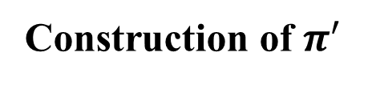






























Example$: N=\{A,B,C,D,E,F,G\}. For any T, c\left(T\right)=1 iff ∃ S⊆ T, S∈ \{\{A,C\},\{B,C\},\{B,D,E\},\{E,F\}\}.$
$$π$$
Construction of $π^{′}$
A cannot be marginal player.
$$A$$
$$B$$
$$C$$
$$D$$
$$E$$
$$F$$
$$G$$
$$A$$
Insert A to the first position.
B cannot be marginal player.
$$B$$
$$A$$
$$B$$
$$C$$
$$D$$
$$E$$
$$F$$
$$G$$
$$A$$
Insert B before A.
$$c\left(\left\{B,C\right\}\right)=1$$
$$C$$
$$A$$
$$B$$
$$C$$
$$D$$
$$E$$
$$F$$
$$G$$
$$B$$
$$A$$
Insert C after B.
D cannot be marginal player.
$$D$$
$$A$$
$$B$$
$$C$$
$$D$$
$$E$$
$$F$$
$$G$$
$$B$$
$$C$$
$$A$$
Insert D before C.
$$c\left(\left\{B,D,E\right\}\right)=1$$
$$E$$
$$A$$
$$B$$
$$C$$
$$D$$
$$E$$
$$F$$
$$G$$
$$B$$
$$D$$
$$C$$
$$A$$
Insert E after D.
F, G cannot be marginal player.
$$G$$
$$F$$
Insert F,G before E.
$$A$$
$$B$$
$$C$$
$$D$$
$$E$$
$$F$$
$$G$$
$$B$$
$$D$$
$$E$$
$$C$$
$$A$$

Slide 35
OIR
Case 1: obvious
Case 2: proof by contradiction.
Original Order
…
A
…
B
B
B
Shuffled Order
…
…
A
If A becomes the marginal player, B should be inserted after A.

Slide 36
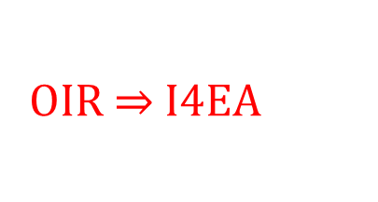
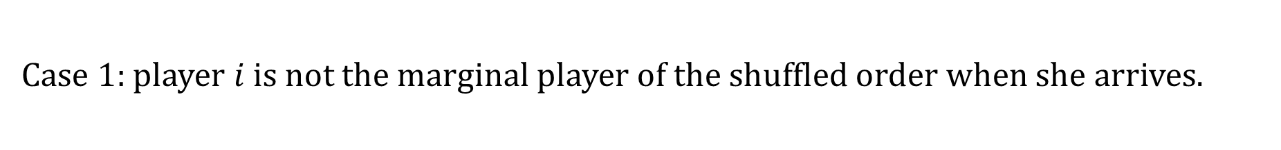
I4EA
Case 1: player $i$ is not the marginal player of the shuffled order when she arrives.
Original Order
…
…
…
A
Unknown
Shuffled Order
…
…
A
…
OIR $⇒$ I4EA

Slide 37



Properties of SFS-CS
Case 2: player $i$ is the marginal player of the shuffled order when she arrives.
Original Order
…
…
A
B
Unknown
…
…
B
A
Unknown
Shuffled Order
$$S_{1}$$
A
$$S_{2}$$
A
$${S_{2}⊆S}_{1}$$

Slide 38

A Class of Mechanisms(GSFS-CS)
$$S_{1}$$
$$1$$
Original Order
Shuffled Order

Slide 39
A Class of Mechanisms(GSFS-CS)
$$S_{1}$$
$$1$$
Original Order
Bijection
Shuffled Order

Slide 40
A Class of Mechanisms(GSFS-CS)
$$S_{1}$$
$$1$$
Original Order
Shuffled Order

Slide 41

A Class of Mechanisms(GSFS-CS)
$$S_{1}$$
$$1$$
Original Order
Shuffled Order
$$1$$

Slide 42

A Class of Mechanisms(GSFS-CS)
$$S_{1}$$
$$1$$
$$S_{2}$$
$$2$$
Original Order
Shuffled Order
$$1$$

Slide 43

A Class of Mechanisms(GSFS-CS)
$$S_{1}$$
$$1$$
$$S_{2}$$
$$2$$
Original Order
Bijection
Shuffled Order
$$1$$

Slide 44
A Class of Mechanisms(GSFS-CS)
$$S_{1}$$
$$1$$
$$S_{2}$$
$$2$$
Original Order
Shuffled Order
$$1$$

Slide 45


A Class of Mechanisms(GSFS-CS)
$$S_{1}$$
$$1$$
$$S_{2}$$
$$2$$
Original Order
Shuffled Order
$$2$$
$$1$$

Slide 46

A Class of Mechanisms(GSFS-CS)
$$S_{1}$$
$$1$$
$$S_{2}$$
$$2$$
$$S_{3}$$
$$3$$
Original Order
Shuffled Order
$$2$$
$$1$$

Slide 47


A Class of Mechanisms(GSFS-CS)
$$S_{1}$$
$$1$$
$$S_{2}$$
$$2$$
$$S_{3}$$
$$3$$
Original Order
Bijection
Shuffled Order
$$2$$
$$1$$

Slide 48
A Class of Mechanisms(GSFS-CS)
$$S_{1}$$
$$1$$
$$S_{2}$$
$$2$$
$$S_{3}$$
$$3$$
Original Order
Shuffled Order
$$2$$
$$1$$

Slide 49



A Class of Mechanisms(GSFS-CS)
$$S_{1}$$
$$1$$
$$S_{2}$$
$$2$$
$$S_{3}$$
$$3$$
Original Order
Shuffled Order
$$3$$
$$2$$
$$1$$

Slide 50
























A Class of Mechanisms(GSFS-CS)
Example$: N=\{A,B,C,D,E,F\}. For any T, c\left(T\right)=1 iff ∃ S⊆ T, S∈ \{\{A\},\{B,D\},\{C,E\}\}.$
Theorem
$$π$$
$π′$ by sfs-shuf
Another possible $π′$
$$A$$
$$B$$
$$C$$
$$D$$
$$E$$
$$F$$
$$A$$
A can produce the cost solely.
$$A$$
$$B$$
$$B$$
$$A$$
$$B$$
$$C$$
$$D$$
$$E$$
$$F$$
$$A$$
$$A$$
Following sfs-shuf, we insert B and C before A in reversed order.
$$C$$
$$C$$
Inserting C between B and A is also available.
$$A$$
$$B$$
$$C$$
$$D$$
$$E$$
$$F$$
$$B$$
$$A$$
$$B$$
$$A$$

Slide 51

























A Class of Mechanisms(GSFS-CS)
Example$: N=\{A,B,C,D,E,F\}. For any T, c\left(T\right)=1 iff ∃ S⊆ T, S∈ \{\{A\},\{B,D\},\{C,E\}\}.$
Theorem
$$π$$
$π′$ by sfs-shuf
Another possible $π′$
$$D$$
$$D$$
$$A$$
$$B$$
$$C$$
$$D$$
$$E$$
$$F$$
$$C$$
$$B$$
$$A$$
$$c\left(\left\{C,B,D\right\}\right)=1$$
$$B$$
$$C$$
$$A$$
$$c\left(\left\{B,D\right\}\right)=1$$
$$E$$
$$E$$
E cannot be
marginal player.
$$A$$
$$B$$
$$C$$
$$D$$
$$E$$
$$F$$
$$C$$
$$B$$
$$D$$
$$A$$
$$B$$
$$D$$
$$C$$
$$A$$
$$c\left(\left\{C,E\right\}\right)=1$$
$$F$$
$$F$$
$$B$$
E
$$D$$
$$C$$
$$A$$
$$A$$
$$B$$
$$C$$
$$D$$
$$E$$
$$F$$
$$C$$
$$E$$
$$B$$
$$D$$
$$A$$
OR
$$F$$
$$B$$
E
$$D$$
$$C$$
$$A$$

Slide 52
Extend GSFS-CS to General Valued Monotone Games
Definition: eGSFS-CS
(1) decompose game online (2) accumulate the share
A
B
C
AB
AC
BC
ABC
A | B | C | AB | AC | BC | ABC
1 | 2 | 3 | 4 | 5 | 6 | 7
1 | 1 | 1 | 1 | 1 | 1 | 1
 | 1 | 1 | 1 | 1 | 1 | 1
 |  | 1 | 1 | 1 | 1 | 1
 |  |  | 1 | 1 | 1 | 1
 |  |  |  | 1 | 1 | 1
 |  |  |  |  | 1 | 1
 |  |  |  |  |  | 1
1
2
3
4
5
6
7
0-1 valued components

Slide 53
Cost Sharing vs Value Sharing
General Monotone Value Sharing
General Monotone Cost Sharing
0-1 Monotone
Games
0-1 Monotone
Cost Sharing
Unsolvable
Solved by Ge et al.
All solvable!
Solved in this work.
Solvable
[1] Ge, Yaoxin, et al. "Incentives for Early Arrival in Cooperative Games." Proceedings of the 23rd International Conference on Autonomous Agents and Multiagent Systems. 2024.(Best Paper Award)
[2]. Zhang, Junyu, et al. "Incentives for Early Arrival in Cost Sharing." arXiv preprint arXiv:2410.18586 (2024).
(Accepted by AAMAS 2025)

Slide 54
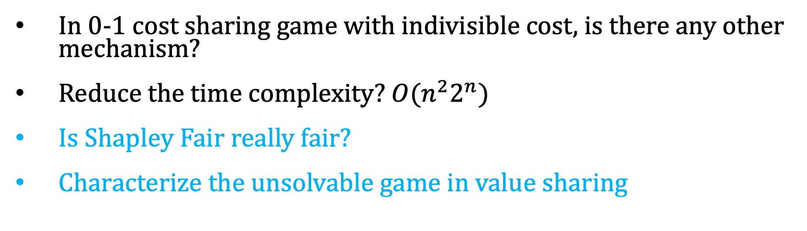
Future Work
In 0-1 cost sharing game with indivisible cost, is there any other mechanism?
Reduce the time complexity? $O(n^{2}2^{n})$
Is Shapley Fair really fair?
Characterize the unsolvable game in value sharing

